Slide 1
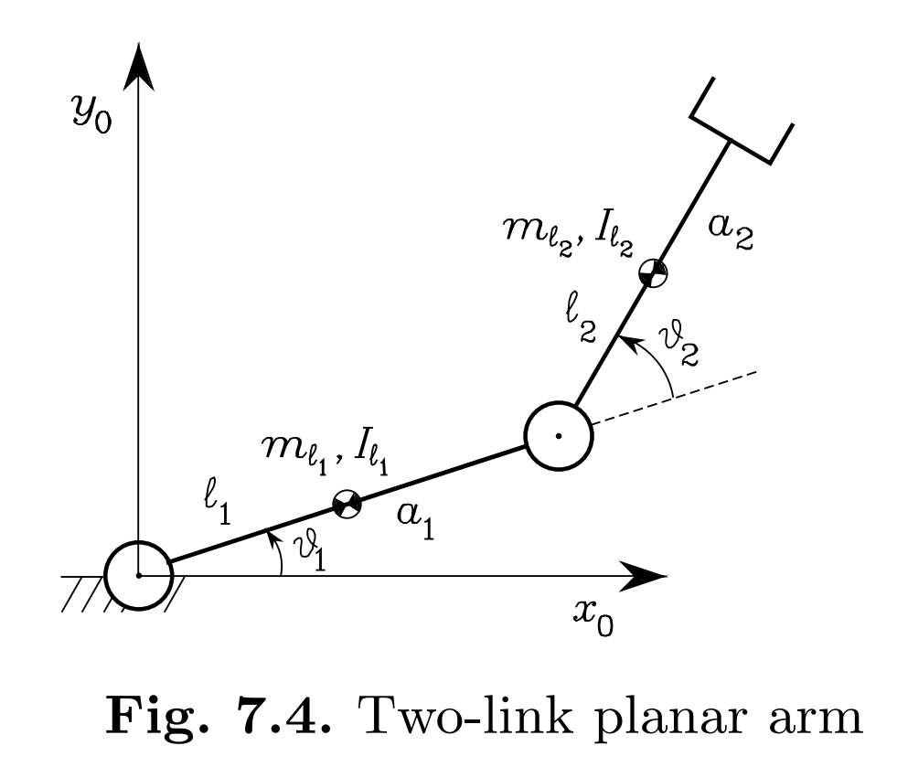
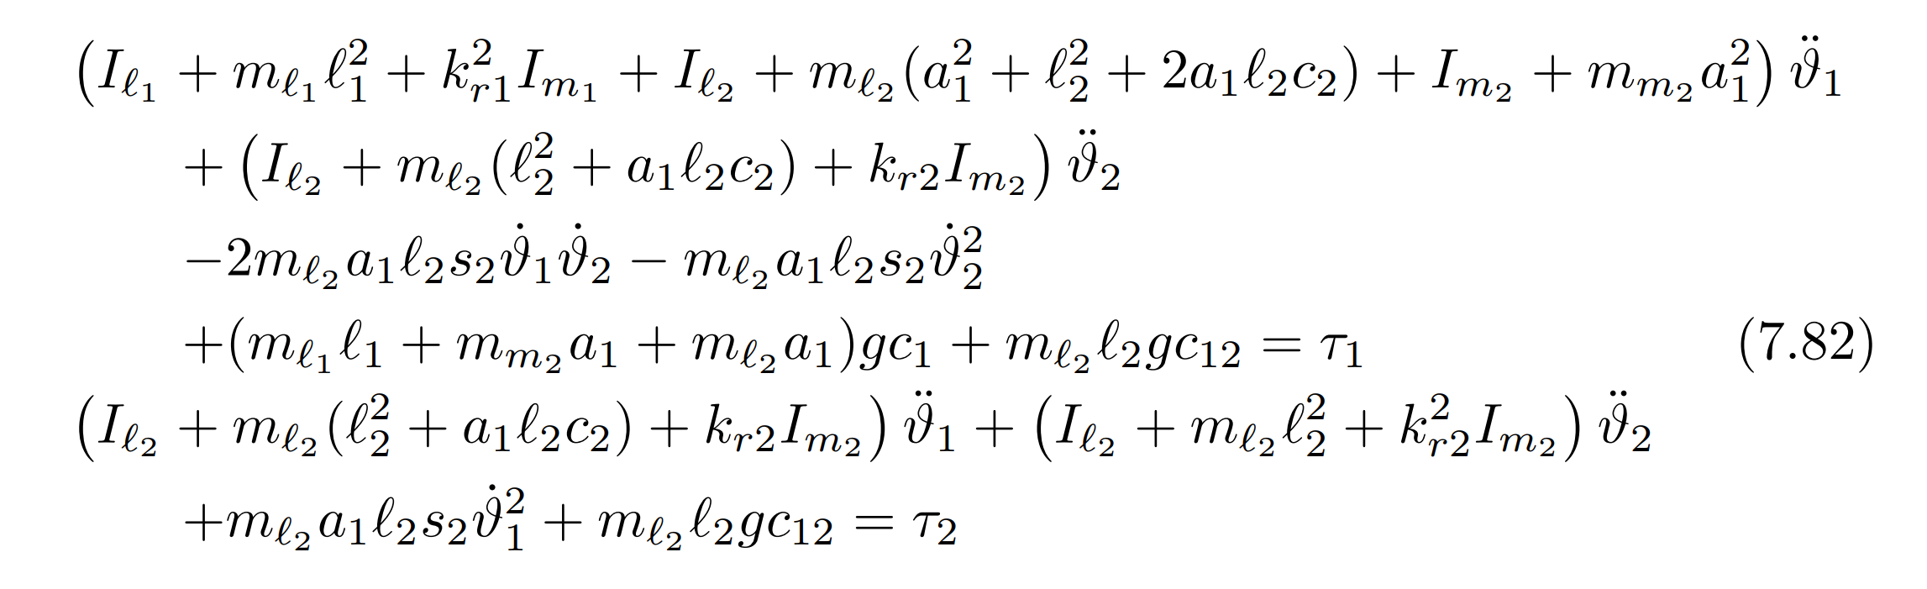
Manipulator dynamics (Lagrange formulation)
Two-link Planar Arm
Equations of Motion
Notes:
In the absence of friction and tip contact forces, the resulting equations of motion are above

Slide 2
Manipulator dynamics (Lagrange formulation)
Two-link Planar Arm
Simulation parameters
Parameter | Value
g | 9.80665 (in Y-direction)
density | 2710; % kg/m3
Link 1 dimensions (x*y*z) | 1m*0.01m*0.001m
Link 2 dimensions (x*y*z) | 0.5m*0.01m*0.001m
ms1 | 0.0271kg
m2 | 0.0136kg
I1 | 0.0023
I2 | 0.0002824
b1 | 0 (no friction), 0.1 (viscous friction)
b2 | 0 (no friction), 0.1 (viscous friction)
assume
zero actuator parameters
links are slender bars
Initial joint angles and velocities are zeros

Slide 3
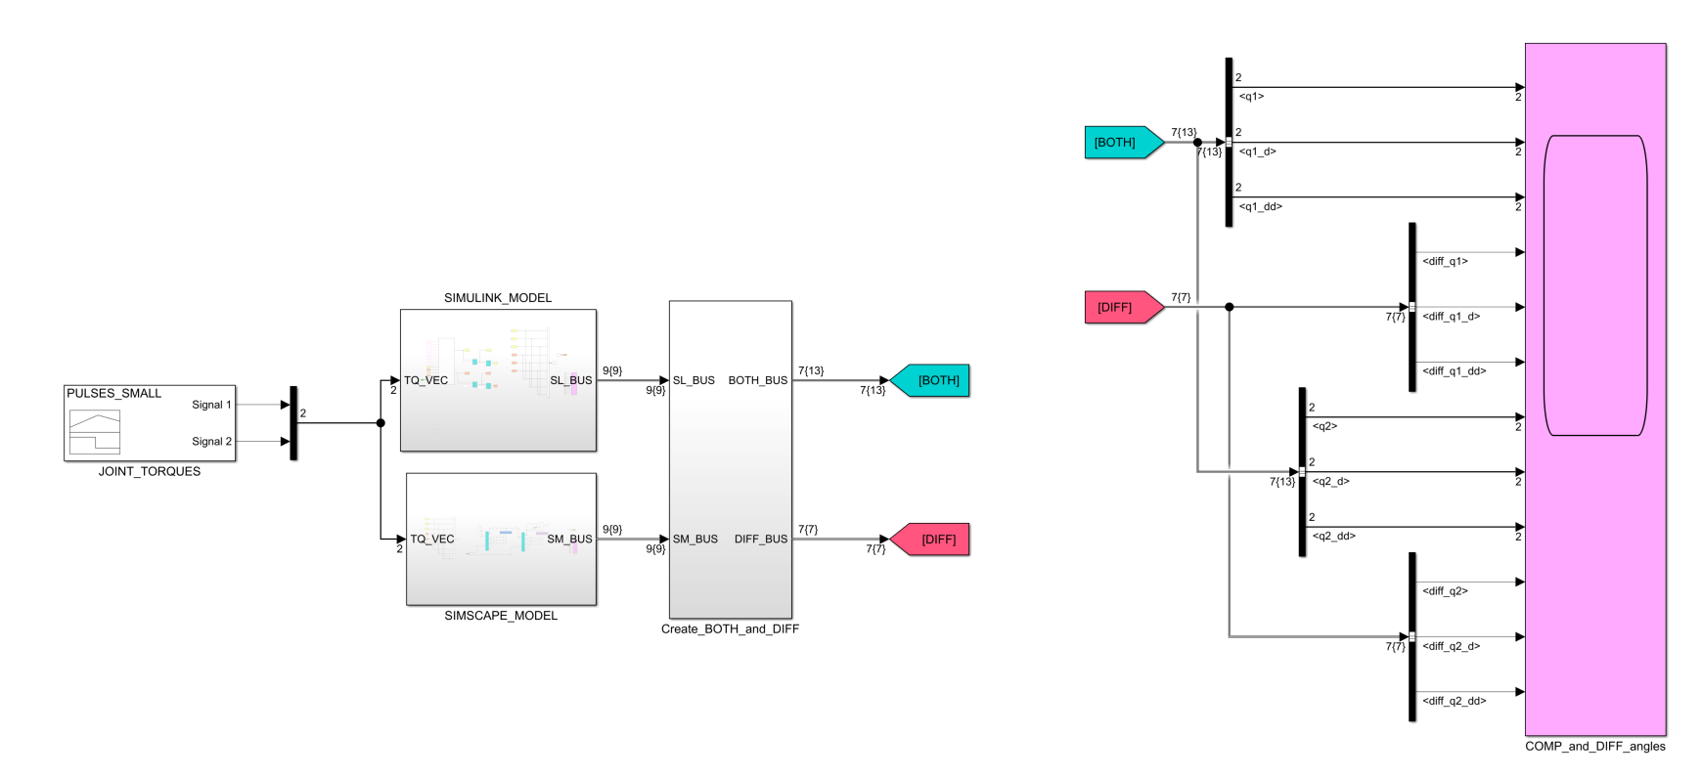
Manipulator dynamics (Lagrange formulation)
Two-link Planar Arm
Simulink Simulation

Slide 4
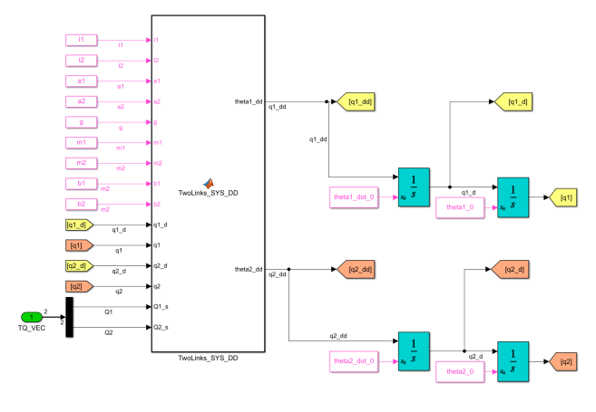
Manipulator dynamics (Lagrange formulation)
Two-link Planar Arm
Manually-derived EOM Implementation

Slide 5
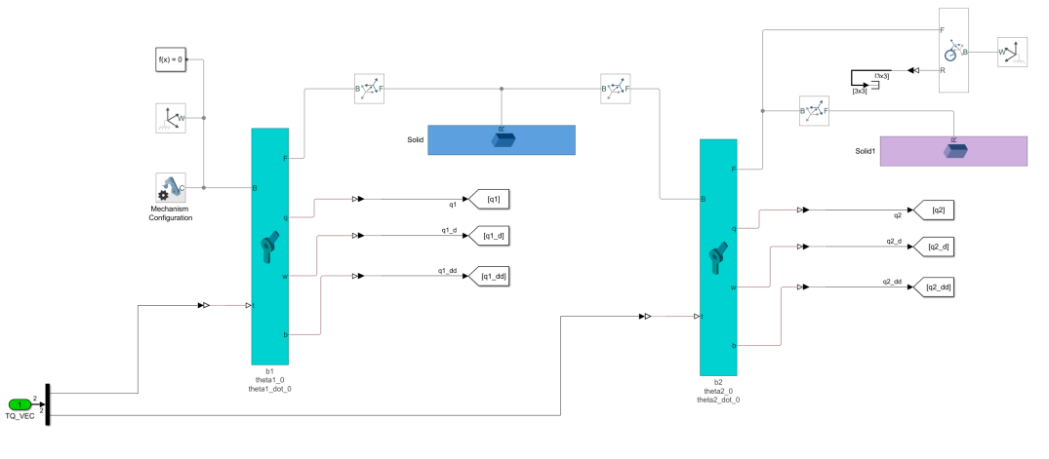
Manipulator dynamics (Lagrange formulation)
Two-link Planar Arm
Simscape multibody Implementation

Slide 6
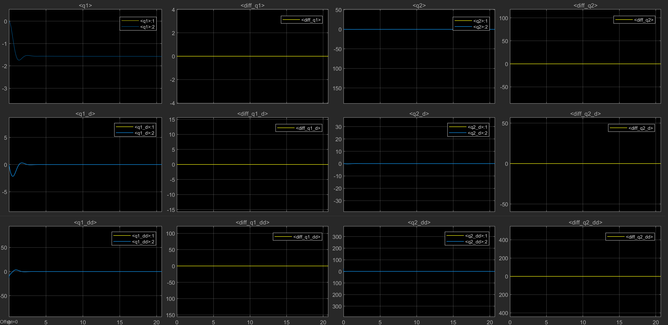
Manipulator dynamics (Lagrange formulation)
Two-link Planar Arm
Simulation results (with viscous friction)
Manual implementation is the same as Simscape

Slide 7
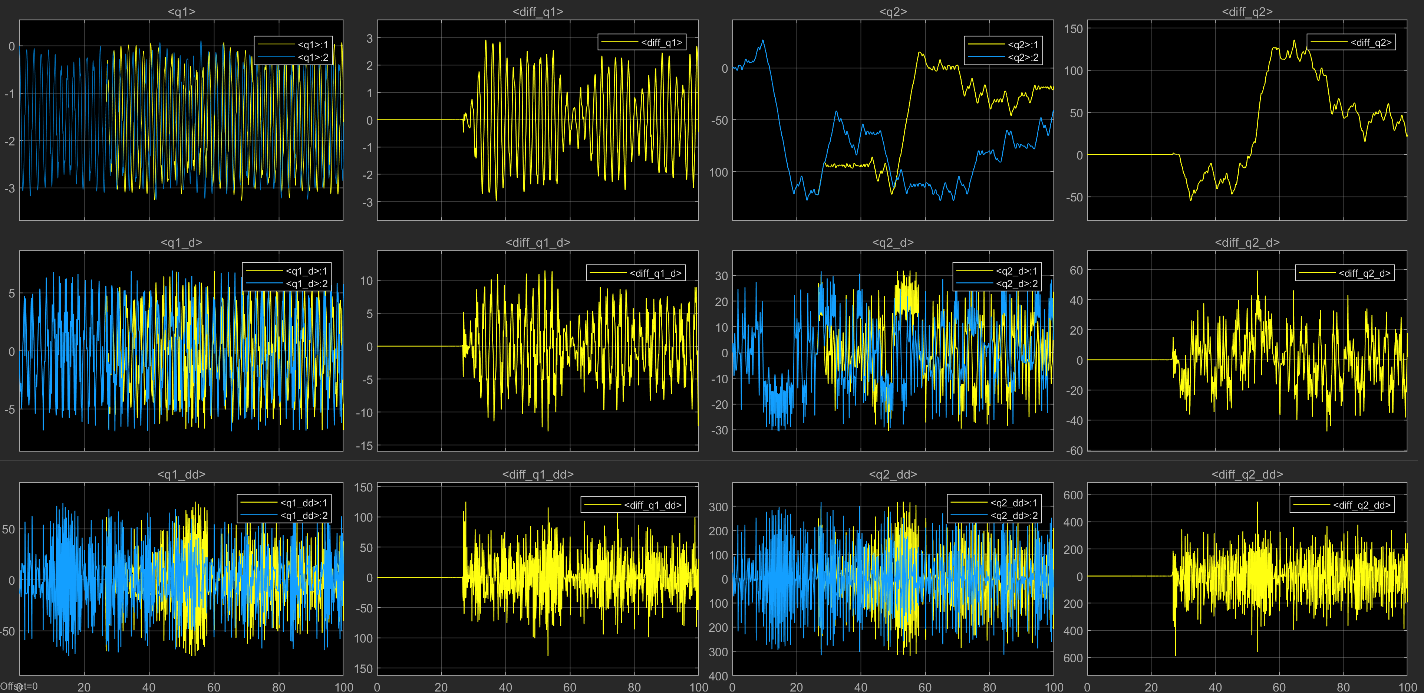
Manipulator dynamics (Lagrange formulation)
Two-link Planar Arm
Simulation results (without friction)
Manual implementation starts to drift from Simpscape after 25s

Slide 8
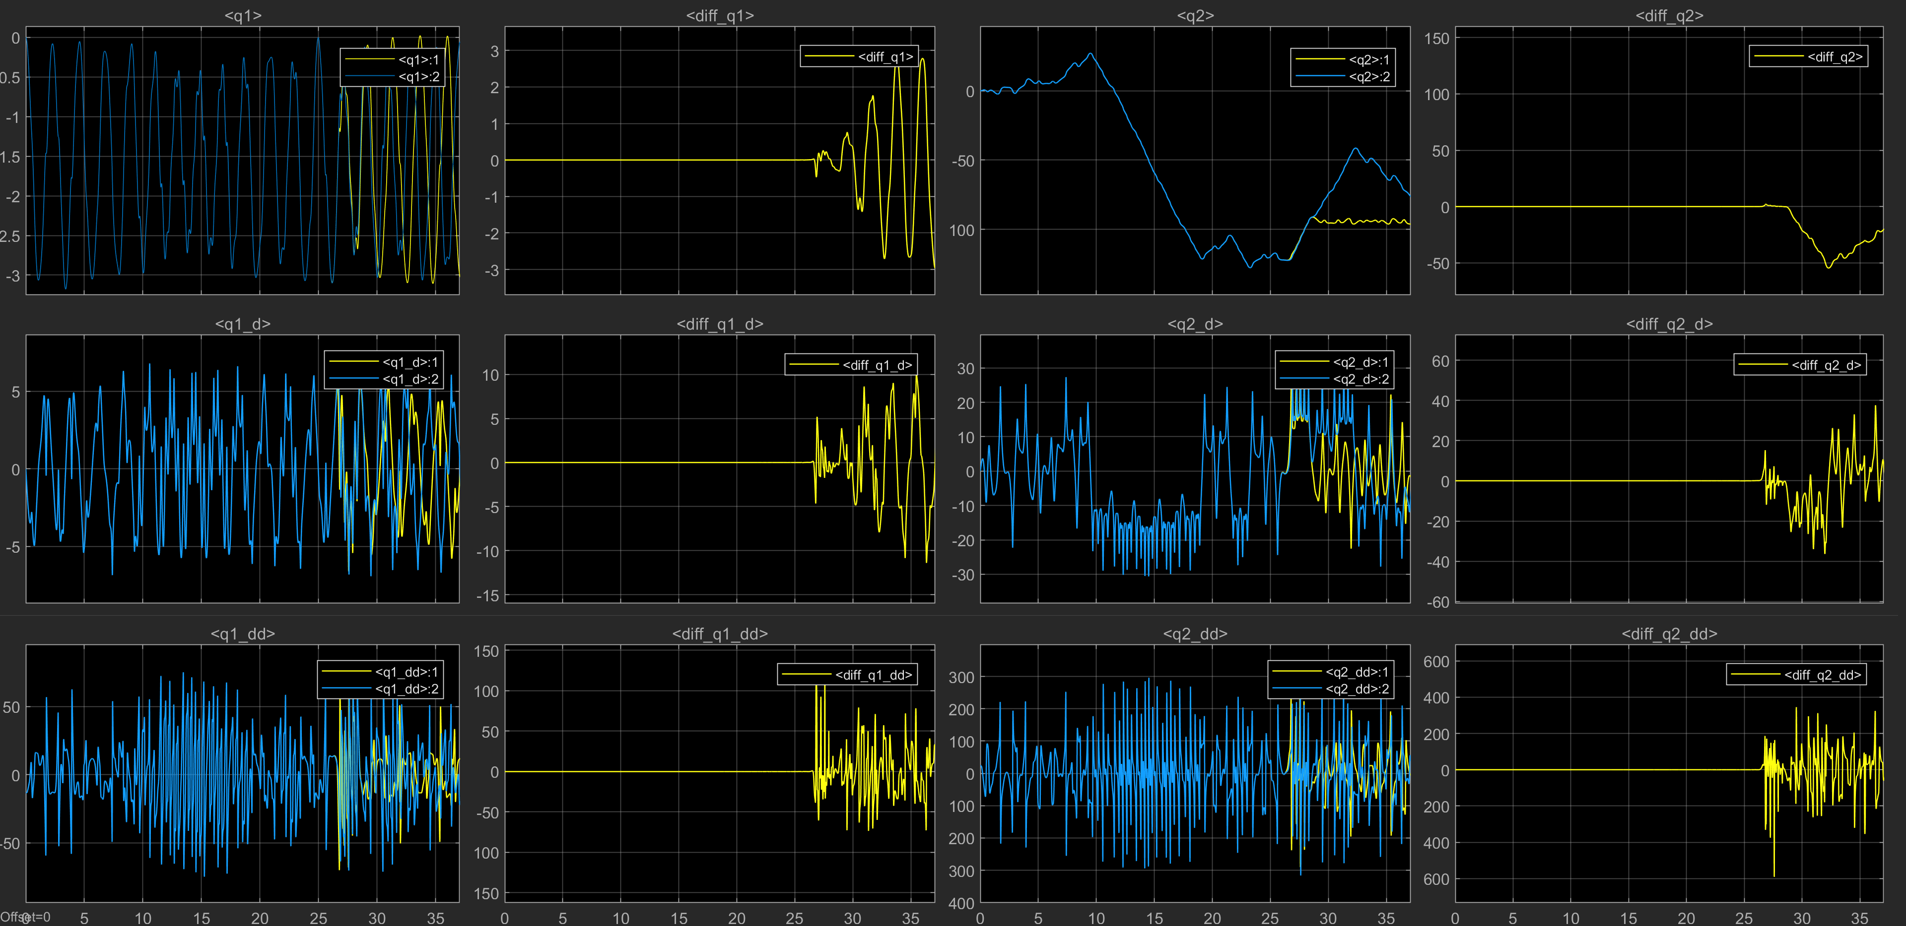
Manipulator dynamics (Lagrange formulation)
Two-link Planar Arm
Simulation results (without friction)

